Slide 1
Mainframe-
JCL & COBOL Basics
Created by :
Kavipriya P

Slide 2
Agenda
What is mainframe & Features
Benefits of Mainframe
Mainframe operating system & Applications
Batch & Online Processing
TSO/ISPF
Datasets
ISPF Utilities
Mainframe Modules
JCL Overview
JCL syntax or Format
JCL statements
JCL coding concepts
JCL utilities
Introduction to COBOL
COBOL Program Structure
COBOL Program Format
Sample Program

Slide 3
What is mainframes?
Mainframes are data servers that are designed to process up to 1 trillion web transactions daily with the highest level of security and reliability
A system which is capable of handling and processing very large amount of data
High-performance system, which can support multiple users.
Features of Mainframe :
Store large volume of data
Very high processing speed
Millions instruction per second
Supports lakhs of user concurrently
Security
It is used by organizations like banking, insurance ,retail etc…

Slide 4
What are the advantages of mainframes?
RAS -- Reliability, Availability, Serviceability
Security
Scalability
Centralized data hub
Workload management
Compliance
Resiliency
Evolving architecture
Application enablement, complexity, variety
Potential for thousands of users
Notes:
Reliability Involves the use of high-quality hardware and software components,
and extensive self-checking and self-recovery by hardware
components.
Availability The system can recover from a failed component without impacting the rest of the system.
Serviceability The mainframe can determine why a failure occurred. This capability allows for replacing hardware and software elements while impacting as little of the operational system as possible.
Security Deliver the highest levels of security with built-in cryptographic cards and innovative software that uses artificial intelligence and machine learning (ML) solutions to help detect cyberattacks or fraud. For instance, modern mainframes can execute up to 1 trillion secure web transactions daily and manage privacy by policy.
Scalability
Support massive simultaneous transactions, data processing and throughput (I/O) with built-in capacity on demand and built-in shared memory for direct application communication.
Resiliency
Offer resiliency through multiple layers of redundancy for every component (for example, power supplies, cooling, backup batteries, CPUs, I/O components, cryptography modules) and testing for extreme weather conditions.
By integrating and extending mainframe capabilities into a hybrid cloud environment, businesses can choose the best environment for their workloads (whether in the cloud or on-premises) to maximize each platform’s innovations, technical advancements, security and resiliency. For instance, an airline company can create an application for customers to manage their travel information, such as cloud-based reservation information. The service can also access data that are held on mainframes, such as changes in flight arrival and departure times. This service doesn’t replace or improve existing mainframe capabilities. Instead, it allows the customer to draw from the best of both worlds: data residing in the cloud and on-premises.

Slide 5
Mainframe Operating system & Applications
Operating Systems
IBM Providing Mainframes i.e Operating systems : Z/OS called Zero Downtime Operating Systems
What do you need to connect with Mainframe ?
Emulator –different emulators are available in markets. TN3270 is now mostly used .
Applications of Mainframe :
Banking applications
Insurance applications
Reservations systems
Telecom communications, Manufacturing and Retails applications
Through cloud also able to connect instead of terminal.
Notes:
Each system is having individual ip address , you need to mention the ip address in emulator and juct click connect option to connect to it.
Banking applications:
Loan Processing
Card Processing
Insurance applications :
Medical insurance
Automobile insurance
Resrvations systems
Airline reservation systems
Railway reservation system
Road transport reservation systems
Telecom communication
-generate reports for monthly, quat
Manufaturing and Retails applications

Slide 6
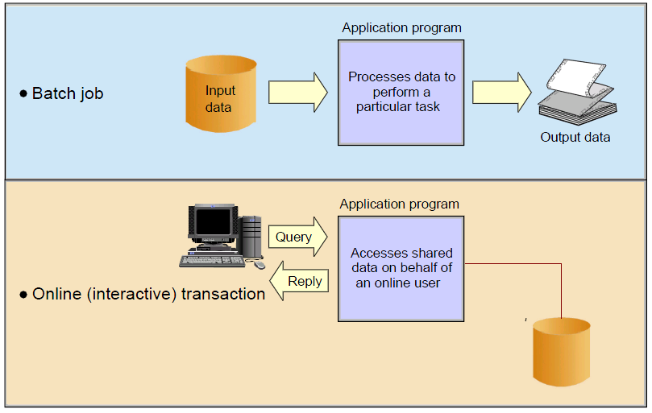
Mainframe Batch and Online Processing

Slide 7
Software Environment –TSO&ISPF
TSO&ISPF ARE MAINFRAME SOFTWARE ENVIRONMENTS
TSO :Time sharing option
It interacts with OS of mainframe .‘Allows multiple users to use operating system at the same time.
ISPF : Interative System ProductivityFacility
It is a software which runs on ibm mainframes
Logon procedure
Once connect to mainframe using emulator in Logon screen -Type TSO OR TSO USERID . You must have a userid and password .

Slide 8
Data sets –PS &PDS
Data is Stored in datasets. They are 2 types
PS –Physical sequential
Like flat file in windows
Used to store and retrieve data in sequential order.
While crating the PS , Directory blocks will always be zero
PDS –Partitioned datasets
Group of data sets
Like a folder in windows which has multiple files in it.
For PDS , Directory blocks will be non-zero value.
Naming conventions :
ABC.DEF.TST –Maximum length 44 characters
Maximum 5 qualifiers .
Maximum 4 periods .
Each qualifuier can be of maximum 8 characters .

Slide 9
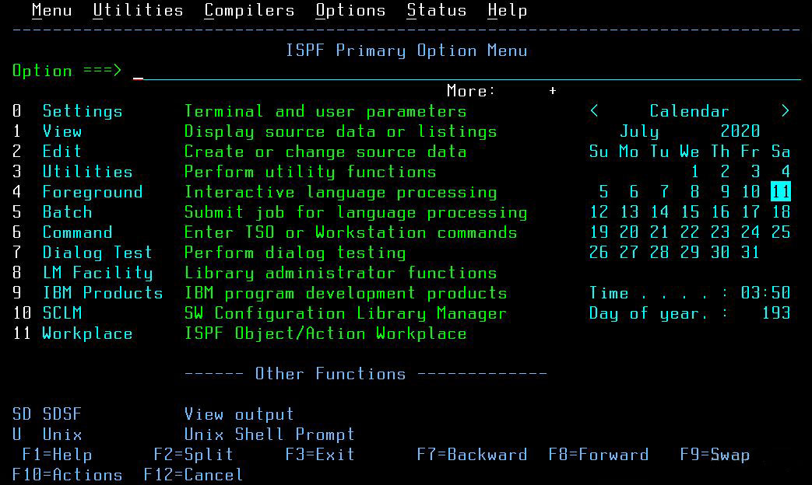
ISPF Primary Option Menu
Notes:
Option zero (O) allows you to change ISPF settings. For example, the command line for your ISPF session might appear at the bottom of the display, while your instructor’s ISPF command line might appear at the top. This is a personal preference, but traditional usage places it at the top of the panel. If you want your command line to appear at the top of the panel, do the following:
Go to the ISPF primary option menu.
Select option 0 to display the Settings menu, as shown in Figure 3-17 on page 3-22.
In the list of Options, remove the “/” on the line that says “Command line at bottom.” Use the Tab or New line key to move the cursor.

Slide 10
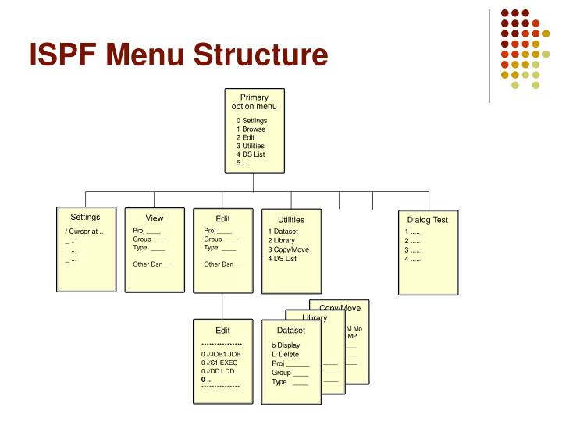
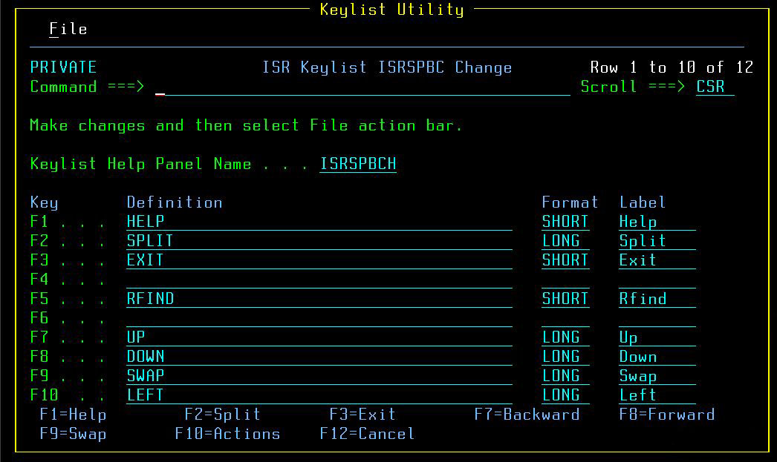
ISPF Primary Option Menu (contd..)
Notes:
In this option 0 - we can view and modify the ISPF parameters. For areas are shown:
Options
Characteristics of the terminal
Printing characteristics
General
Function keys
User profile
Through ISPF Primary Option Menu Panel, "1" for View and "2" for Edit.
Through Dataset List Utility - 3.4 (Option 4 under Utility Selection Panel) as mentioned in previous section. By entering "b" or "v" or "e" to the left side of Dataset or Member name, Browse, View, Edit Options can be invoked respectively.
FIND is most frequently used command in View, Edit, Browse.
Option 12 in the Utilities Menu is a simple compare utility and option 13 from the Utilities Menu is the extended compare utility.
Search-For Utility Option:
This option is used to search for a particular string in a dataset or members of a PDS. For example, if you want to know the list of programs that call a particular sub-program, say a currency conversion routine, you can use this utility to search for the sub-program name in the library where all the main programs are stored.

Slide 11
Mainframe Modules
JCL
VSAM
COBOL
CICS
DB2
IMS
Tools (Endevor, Fileaid ,Xpeditor)
Notes:
Time Sharing Option/Extensions (TSO/E) allows users to create an interactive session with the z/OS® system. TSO provides a single-user logon capability and a basic command prompt interface to z/OS.
Any business application is divided into logical modules and these modules are developed using programming languages. These programs should be executed in a pre-defined sequence to achieve the business functionality.
JCL (Job Control Language) is used to DEFINE and CONTROL the JOB to the operating system.
COBOL:
First language developed for commercial application development, which can
efficiently handle millions of data. English Like language – Easy to learn, code and maintain.
Virtual Storage Access Method (VSAM) applies to both a data set type and the access method used to manage various user data types. With VSAM you can load files, retrieve records from files, update files, and add, replace, and delete records in files.
CICS (Customer Information Control System) is middleware that sits between the z/OS IBM mainframe operating system and business applications. As an online transaction processing (OLTP) system, it is used to build customer transaction application programs.
DB2:
It manages core business data across an enterprise and supports key business applications. Db2 for z/OS supports thousands of customers and millions of users. It remains continuously available, scalable, and highly secure.
IMS Database Manager (IMS DB) -Information Management System: A database management system for defining database structure, organizing business data, performing queries against the data, and performing database transactions
Endevor : Source code management tool for mainframes running on Z/OS. Endevor was designed to automate the development process, governing software change from the very first line of code through deployment and includes change tracking.

Slide 12
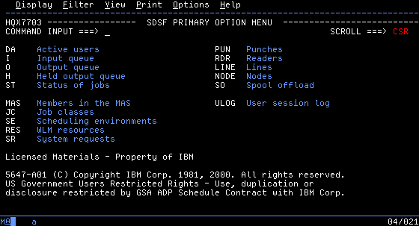
Option SDSF – Execution Queries
This option lets us control jobs, know their status, edit execution listings, cancel executions, etc. When we select it this panel appears:
Execution Queues Screen

Slide 13
JCL Overview
JCL :
Job Control Language (JCL) is a language that directs the Operating systems in the handling of application programs.
JCL is a mean of communication between an application program and the computers operating system (MVS).
It is a set of control statements that provide the specifications necessary to process a JOB.
Job: Execution of one or more related programs in sequence.
Job step: Each program to be executed by a job.
What can be done with JCL?
Submit a job to the operating system.
Request resources needed to run the job.
Control the systems processing of the job.
You can pass parameter values through JCL to application program using PARM parameter in EXEC statement.

Slide 14
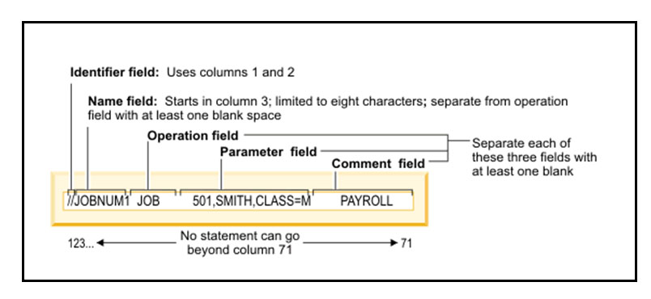
JOB
What is a Job?
  A job is defined as execution of one or more related programs in a sequence.
  It provides the communication between an application program (Example: COBOL, Assembler or PL/I) and the computers operating system.
Job flow :
During execution a job goes through the following phases:
  Input
  Conversion
  Execution
  Output
Job Statement Structure:
  JCL statements are coded in 80 bytes.
  72 of the 80 columns are available to code JCL.
  Last 8 columns are reserved for an optional sequence number.

Slide 15
JCL - STATEMENTS
There are three important statements in JCL.
JOB
DD
JOB Statement:
The job statement or job card must always be the first JCL statement coded for a job.
Three basic functions performed by this statement are as follows:
Identifies a job to MVS and supplies a job name that MVS uses to refer to the job.
Supplies accounting information.
It supplies various options that influence or limit how the job is processed.
EXEC Statement:
The EXEC statement identifies each step in a job.
This statement holds the job step program/procedure information is the EXEC statement.
DD Statement:
The DD statements are used to define the datasets.
It describes the data sets that are used by the program.
We can code one DD statement for each data set.
Always code the DD statements after the EXEC statement that identifies the job step.
DD statements are the most complicated of the JCL statements.
EXEC

Slide 16
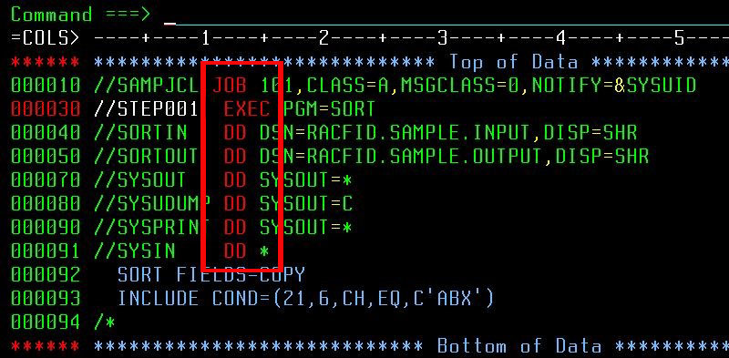
Sample JCL
How to continue JCL statements?
Notes:
4. Parameters Field:
The parameters field begins at least one position after the end of the operation field and can extend into column 71:
Within the parameters field, we have to code one or more parameters that supply information that influences how the statement is processed.
When a parameters field consists of more than one parameter, the individual parameters should be separated with commas.
MVS assumes that the parameters field is complete when it encounters a space so do not include a space by accident. If you need to include a space as part of a parameter value, the parameter value must be enclosed in apostrophes.
There are two types of parameters:
Positional
Keyword
5. Comments Field:
The comments field begins in the position after the space that marks the end of the parameters field and ends in column 71.
You can also use an entire line as a comment. you need to code //* starting from column one of the JCL record.
How to continue JCL statements?
Break the parameter field after the comma that follows a parameter or sub-parameter.
Code slashes in columns 1 and 2 of the following line.
Code the next parameter beginning anywhere in columns 4 through 16.

Slide 17
JCL - Coding Concepts
Creating a data set member for JCL
Coding JCL (using a predefined sample)
Submitting the job
Viewing the job output
//SORT001 JOB '417','SRINI',NOTIFY=XSR12345,MSGCLASS=S,
// MSGLEVEL=(1,1),CLASS=C ---> JOB statement with parameters //*
//STEP1 EXEC PGM=SORT ---> EXEC statements to execute SORT utility
//SYSIN DD * ---> DD statement with DD name SYSIN, specifies how you want the sort to be done SORT FIELDS=(1,10,CH,A)
/*
//SYSOUT DD SYSOUT=* ----> DD statement with DD name SYSOUT, specifies the data set to which SORT will write its messages. //SORTIN DD * ---> DD statement with DD name SORTIN, specifies input records or file.
JANUARY
FEBRUARY
MARCH
APRIL
MAY
JUNE
JULY
AUGUST
SEPTEMBER
OCTOBER
NOVEMBER
DECEMBER
/*
//SORTOUT DD SYSOUT=* ---> DD statement with DD name SORTOUT, specifies output record will be return.
/*

Slide 18
Mainframe Utilities
IDCAMS Utility
IEBGENER Utility
IEFBR14 Utility
IEBCOPY Utility
Notes:
IBM mainframe utility programs are utility software supplied with IBM mainframe operating systems such as MVS and zOS to carry out various tasks associated with maintenance of the computer system or datasets.
IDCAMS ("Access Method Services") generates and modifies Virtual Storage Access Method (VSAM) and Non-VSAM datasets.
IEBCOPY copies, compresses and merges partitioned data sets. It can also select or exclude specified members during the copy operation, and rename or replace members.
IEBGENER copies records from a sequential dataset, or creates a partitioned dataset.
Some of the tasks that IEBGENER can perform include the following:
Creating a backup of a sequential data set or a member of a PDS.
Changing the physical block size or logical record length of a sequential data set.
Creating an edited data set.
Printing a sequential data set or a member of a PDS.
Creating partitioned output data set from sequential input data set.
IEFBR14 is a dummy program, normally inserted in JCL when the only desired action is allocation or deletion of datasets.

Slide 19
COBOL
COBOL is an acronym for Common Business-Oriented Language
High-level programming language in compiled English like computer programming language that is widely used to develop business-oriented applications in commercial data processing.
Cobol is mainly used in large scale Batch and On-Line transaction processing jobs.
It was developed by Conference of Data System Languages (CODASYL) to fix complex business processes and data processing as standardized, efficient and readable language
Used in business, finance, and administrative systems for companies like transaction processing jobs.es and governments.
Why most of business applications are developed using Mainframe COBOL?
Can handle huge volumes of data
Widely used across business applications, administrations and easy to maintain.
With CICS(Customer Information Control System) as front end.
COBOL is suitable for Online applications like Railway Reservation, Online Banking etc. Railway Reservation, Online Banking etc.
Notes:
COBOL is a high-level language. One must understand the way COBOL works. Computers only understand machine code, a binary stream of 0s and 1s. COBOL code must be converted into machine code using a compiler. Run the program source through a compiler. The compiler first checks for any syntax errors and then converts it into machine language. The compiler creates an output file which is known as load module. This output file contains executable code in the form of 0s and 1s.
Suitable for batch processing applications like Payroll, Telephone, Electricity Billing and Financial Payroll, Telephone, Electricity Billing and Financial Accounting etc., Accounting etc., Batch processing is also known as periodical Batch processing is also known as periodical processing processing

Slide 20
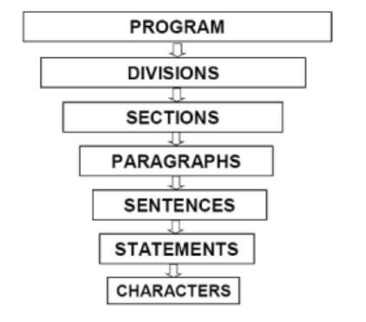
COBOL PROGRAM STRUCTURE
A COBOL program structure consists of divisions
Notes:
Sections are the logical subdivision of program logic. A section is a collection of paragraphs.
Paragraphs are the subdivision of a section or division. It is either a userdefined or a predefined name followed by a period, and consists of zero or more sentences/entries.
sentences are the combination of one or more statements. Sentences appear only in the Procedure division. A sentence must end with a period. • Statements are meaningful COBOL statements that perform some processing.
Characters are the lowest in the hierarchy and cannot be divisible.

Slide 21
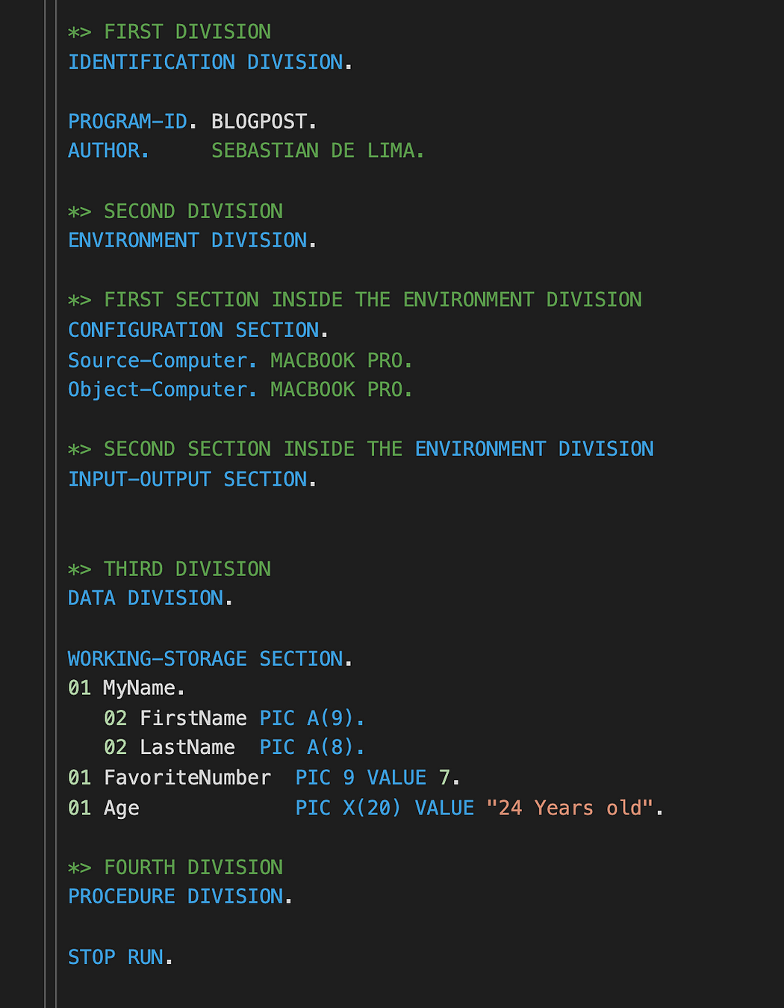
Divisions in COBOL
There are four divisions in a COBOL program
  Identification Division.
  Environment Division.
  Data Division.
  Procedure Division.
  Note :
  Level numbers indicate subordination of fields.
  Use levels 01-49 and 66, 77, 88 have special significance
Notes:
The objective of this first division is to give the program a name, an author, and even the date when it was written. While giving the program an author and a date are optional, all programs must have a name or a PROGRAM-ID.
The objective of this second division is to specify certain specifications regarding, file processing, what computer the program is running on, or country-specific information. All that is inside this section is only used for documentation purposes so it won’t change how the code is compiled or executed. Inside this division we have two sections: The Configuration section and the Input-output section.
Inside of the configuration section we specify the type of computer that the program was compiled and used.
We use a source-computer to specify the type of computer that is used to compile and object-computer for the type of computer that runs the program. In those times computer programs had a lot of dependencies, meaning that certain programs could only be used in certain computers but nowadays you can write a program in Windows and manipulate it with Linux.
Then we have the environment section where we can specify a number of different things like, what files we are going to use from an external source, where the files need to be accessed from, the Disk, tape, etc. or how the reading can be like sequential, random, dynamic, etc. As I said all of the ENVIRONMENT DIVISION is optional
DATA DIVISION
The objective of this division is to define all the variables or constants that will be used in the program, so this division is pretty important. This division has four sections, file section where we specify data sent or received from the local storage of your computer, working-storage section where all the variables or constants are defined, linkage defines the data or variables that will be available for other programs, and report is used to write any documentation regarding reports. I will be going over working-storage in this blog because its the most essential part.
Working-storage
Working storage is where all are variables or constants will be declared, there are three main data-types in COBOL: Alphanumeric(A combination of numbers and letters) to define them we need to use an “X”, Alphabetic(only letters) to define them we need to use an “A”, and Numbers, to define them we use a 9. For all data-types, we write “PIC” before defining the data-type of the variable.
When we want to create variables we must follow a certain structure, variables can be nested into other variables, to differentiate the parent variable to its children we must add a number before the given name of the variable this will indicate COBOL the “position of the variable”. So before you get confused let’s see how we can put all this information together to actually write some code and understand what I am saying.
Here we can see that before every variable I am specifying that they are all “parent” variables. If you notice there is a parenthesis after each data-specification, inside of that parenthesis we will specify the number of maximum characters that the variable can have, having in mind that spaces also count as a character. Then we specify the value of each variable using the “VALUE” keyword, so MyName will now be equal to “Sebastian De Lima”, FavoriteNumber will equal 7, and Age “24 years old”, it’s important to keep in mind that we don’t need to necessarily give the variables a value right of the bat, we can always add the value in the next division, the procedure division.
PROCEDURE DIVISION
This is where we give the instructions to our program, here we utilize our variables and generate the flow of our application. I like to think that the DATA-DIVISION are all the ingredients to make a meal and the PROCEDURE-DIVISION is when we actually cook the meal, we add a certain quantity of the ingredients and cook them in a specific time, this is the same with this division. There are a lot of different tools that we can use for this division, here we can perform mathematical operations, get input from the user while saving it to a variable, output things to the console, and so much more.
So to execute are code we have different “verbs” that will tell our program what to do, in this blog I will talk about 4 main ones: DISPLAY, ACCEPT, COMPUTE, and MOVE.
Level – identifies the position of the variable in a hierarchical structure
Picture clause - Describes the number of digits or characters in the field, whether the field has a sign, and any editing characters the field contains
Usage clause – identifies the type of data, if omitted, usage is DISPLAY.
Can be declared USAGE IS PACKED-DECIMAL
Display
“Display” is the command that will output to the console, you may know it as “console.log()” in JavaScript, “puts” in Ruby, or maybe stdout in C. To use display we simply write display and whatever we want to output, it can be a variable, a string, number, or all of the three combined, you can really display anything you want. Let’s try to display all the variables we previously saved in the past division.
Here I’m simply displaying my name followed by my favorite number and my age, notice how you can interpolate strings and variables without a problem. The “STOP RUN” keyword at the end is simply telling our program to end.
ACCEPT
The accept verb is a command that will display a prompt in the console so that the user can input data, we can ask the user for any information, name, favorite food, and in this case date of birth. To use ACCEPT is the same as DISPLAY.
COMPUTE
Compute is used to execute mathematical operations.
So first we initialize the numbers that we want to use in our operations and another variable to store the result. Let’s see how we can add, subtract, multiply, and divide using this verb.
So here we are simply saving the result of each operation into the result variable and displaying it afterward,
MOVE
“Move” is very simple as well, the function of this verb is to assign values into variables we can change the values of any variables with this verb,

Slide 22
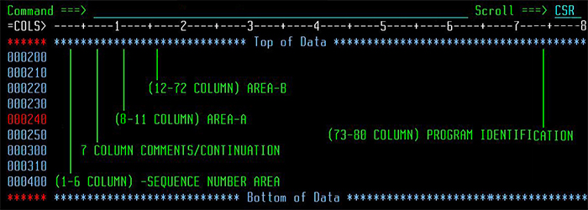
COBOL PROGRAM FORMAT
Code a COBOL program in a member of a PDS called source library. This member contains 80 characters length.
A COBOL program needs to be coded following the below mentioned coding rules.
Note : Division, Section, Paragraph Names and Sentences must end with a period followed by at least one space.
Notes:
Columns 1 through 6 : Sequence Number Area The sequence number area may be used to label a source statement line. The content of this area may consist of any character in the character set of the computer. Column 7 : Indicator Area (comments and continuation) Any sentence, entry, clause, or phrase that requires more than one line can be continued in Area B of the next line which is not a
Comment line
Blank line Area A of a continuation line must be blank.
If no hyphen (-) in indicator Area.
Last character of the preceding line is assumed to be followed by a space.
If hyphen is in Indicator Area: First non-blank character of this continuation line immediately follows the last non-blank char of continues line.
If the continued line contains a non-numeric literal without a closing quotation mark:
All spaces at the end of the continued line (through column 72) are part of the litral.
Continuation line must contain a hyphen in the indicator area.
First non-blank character must be a quotation mark and Literal.
Continues with the character following the quotation mark.
Columns 8 through 11 : Area A The following items must begin in Area A:
Division header
Section header
Paragraph header or paragraph name
Level indicator or level-number (01 and 77)
DECLARATIVES and END DECLARATIVES.
End program header.
Area B: Columns 12 through 72: Entries, sentences, statements, clauses
Continuation lines.
Program Identification: Columns 73 through 80 -This area was originally designed for entering the program identification on each individual line of code

Slide 23
COBOL - Basic Verbs
The Procedure division contains the code used to perform the manipulation of the data described in the Data Division.
The procedure division uses COBOL verbs for data processing. A statement always initiates with a COBOL verb.
In COBOL, there are several verbs with different types of actions. Let's see few of them now,
  Input Verb - ACCEPT
  Output Verb - DISPLAY
  Data Manipulation - INITIALIZE
  Data Manipulation - MOVE
  Program Branching Verbs - STOP RUN
 | Alphabetic | Alpha-numeric | Numeric | Floating-point
Alphabetic and SPACE | Y | Y | N | N
Alphanumeric | Y | Y | Y | Y
Numeric integer and ZERO | N | Y | Y | Y
Floating-point | N | N | Y | Y
Notes:
ACCEPT:
The ACCEPT statement is used to acquire data from the primary input device or various system fields.
Tips:
Use the ACCEPT statement to acquire small amounts of data such as parameters to be entered at runtime.
The chief advantage of acquiring data with the ACCEPT statement is that no file needs to be established to use it.
The chief disadvantage of acquiring data with the ACCEPT statement is that there is no mechanism to recognize end of file.
Many COBOLs have added enhancements to allow access to a four-digit year due to the Y2K problem. Check your system manual for details.
DISPLAY:
The DISPLAY statement is used to exhibit data upon the primary output device.
Tips:
Use the DISPLAY statement to exhibit small amounts of data such as error messages.
The chief advantage of exhibiting data with the DISPLAY statement is that no file needs to be established to use it.
The chief disadvantage of exhibiting data with the DISPLAY statement is that there is no mechanism to supply carriage control.
INITIALIZE: The INITIALIZE statement is used to initialize data items. Data items are initialized according to their type.
Alphabetic and alphanumeric items are initialized to spaces.
Numeric items are initialized to zeros.
For group items, the subordinate elementary items are initialized depending on their individual data types. Only named items are initialized.
The REPLACING phrase can be used to initialize data items to different values other than the default SPACES or ZEROS.
Tips: Use the initialize statement instead of moving ZEROS or SPACES to a group. That way, each subordinate item will be set to an appropriate value.
Notice that unnamed and FILLER items are not initialized. This allows the variable portion of a detail line, for example, to be initialized without the constant values inserted into the unnamed fields being affected.
MOVE: The MOVE statement is used to copy data items to other data items. Below two formats works slightly differently and is described below as well.
it is required to move some of the data item of one group to some other data item of other group. If the names of the corresponding data items are distinct then separate MOVE statements have to be used. But if the corresponding data items have identical names, then instead of separate MOVE statements, MOVE CORRESPONDING can be used.
STOP RUN:
STOP RUN is the last executable statement in the program which will returns the control back to OS.
STOP RUN always coded in the main program.
If STOP RUN coded in the sub program, the control will return to OS instead of returning to main program. In this case, the remaining task coded in main program will be incomplete.
STOP RUN closes all opened files in the program.
When the STOP RUN executed, immediately all running tasks by the program will be closed and control transfers to OS.
STOP RUN terminates the program. STOP literal displays the literal and waits for a response before continuing with the next executable statement.
STOP RUN always terminates the current program execution regardless of the program type (main program or sub program).
Tips: Use the STOP RUN statement to terminate execution of a program.
Do no use the STOP RUN statement in a called subprogram, as it will cause the termination of the entire run unit. Instead, to terminate execution of a subprogram, use the EXIT PROGRAM statement.

Slide 24
COBOL PROGRAM -1
.
IDENTIFICATION DIVISION.
PROGRAM-ID. TSTVERBS.
ENVIRONMENT DIVISION.
DATA DIVISION.
WORKING-STORAGE SECTION.
01 INPUT-AGE PIC 9(03).
01 INPUT-GENDER PIC X(01).
01 AGE PIC 9(03) VALUE ZEROES.
01 GENDER PIC X(01) VALUE SPACES.
PROCEDURE DIVISION.
INITIALIZE INPUT-AGE
INPUT-GENDER. ----> Good to initilize the variable before use it. Or
we can declare VALUE Clause(see AGE & GENDER in working storage section)
ACCEPT INPUT-AGE. ----> Value shoud be passed from JCL
ACCEPT INPUT-GENDER. ----> Value shoud be passed from JCL
MOVE INPUT-AGE TO AGE. ----> Passing value from INPUT-AGE to AGE variable.
MOVE INPUT-GENDER TO GENDER. ----> Passing value from INPUT-GENDER to GENDER variable.
DISPLAY AGE. ----> Write the AGE value to output.
DISPLAY GENDER.- ----> Write the GENDER value to output.
STOP RUN. -----> Returns the control back to OS
Notes:
Columns 1 through 6 : Sequence Number Area The sequence number area may be used to label a source statement line. The content of this area may consist of any character in the character set of the computer. Column 7 : Indicator Area (comments and continuation) Any sentence, entry, clause, or phrase that requires more than one line can be continued in Area B of the next line which is not a
Comment line
Blank line Area A of a continuation line must be blank.
If no hyphen (-) in indicator Area.
Last character of the preceding line is assumed to be followed by a space.
If hyphen is in Indicator Area: First non-blank character of this continuation line immediately follows the last non-blank char of continues line.
If the continued line contains a non-numeric literal without a closing quotation mark:
All spaces at the end of the continued line (through column 72) are part of the litral.
Continuation line must contain a hyphen in the indicator area.
First non-blank character must be a quotation mark and Literal.
Continues with the character following the quotation mark.
Columns 8 through 11 : Area A The following items must begin in Area A:
Division header
Section header
Paragraph header or paragraph name
Level indicator or level-number (01 and 77)
DECLARATIVES and END DECLARATIVES.
End program header.
Area B: Columns 12 through 72: Entries, sentences, statements, clauses
Continuation lines.
Program Identification: Columns 73 through 80 -This area was originally designed for entering the program identification on each individual line of code

Slide 25
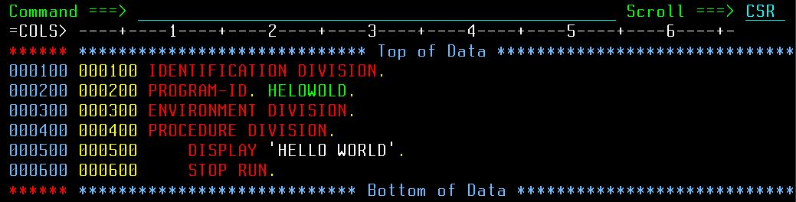
COBOL PROGRAM -2
Output :
‘HELLO WORLD ‘
.
Notes:
Line 1 : IDENTIFICATION DIVISION. - this division is mandatory.
Line 2 : PROGRAM-ID. IDSAMPLE. - it is mandatory to declare the program id name-IDSAMPLE in indentification division. usually this name is same as PDS member name(file name).
Line 3 : ENVIRONMENT DIVISION. - this division is optional.
Line 4 : PROCEDURE DIVISION. - this division is mandatory.
Line 5 : DISPLAY 'HELLO WORLD'. - DISPLAY statement used to transfer the data to the output device/screen. Output device can be decided based on the SYSOUT in JCL if it is a batch program. Here display statement is used to diplay hardcoded value 'HELLO WORLD’.
Line 6 : STOP RUN. - End of program. It is mandatoy to add at the end of program. This is the last executable statement in the program which will returns the control back to OS. STOP RUN always coded in the main program. If STOP RUN coded in the sub program, the control will return to OS instead of returning to main program.
Points to remember: Sequence number present in column 1-6. this is auto generated. Developer don't need to add.
All division name should starts from column 8(Area A). also program id.
DISPLAY & STOP RUN statement should starts from column 12(Area B).
Have you noted color of each word in the statments? It is because like other programming language mainframe(Emulator) differentiate the user word/statement by color. System defined words are in RED color. Hard coded values are in WHITE color. User defined words are in GREEN color.

Slide 26
Questions
Notes:
Key Message(s): NA
Additional Information: NA
Application Delivery Fundamentals (ADF) 2.0: Testing
Module 02: Introduction to Software Development Life Cycle (SDLC)

Slide 27
Thank You !!!!
That’s all for the overview
Keep Learning…

